Slide 1
Diabetes Dataset Report
BY : ANUJ KUMAR

Slide 2
LOGISTIC REGRESSION
In statistics, the logistic model (or logit model) is used to model the probability of a certain class or event existing such as pass/fail, win/lose, alive/dead or healthy/sick. This can be extended to model several classes of events such as determining whether an image contains a cat, dog, lion, etc. Each object being detected in the image would be assigned a probability between 0 and 1, with a sum of one.
Logistic regression is a statistical model that in its basic form uses a logistic function to model a binary dependent variable, although many more complex extensions exist. Mathematically, a binary logistic model has a dependent variable with two possible values, such as pass/fail which is represented by an indicator variable, where the two values are labeled "0" and "1".

Slide 3
WHY LOGISTIC REGRESSION IN THIS DATASET?
It is a Machine Learning classification algorithm that is used to predict the probability of a categorical dependent variable. In logistic regression, the dependent variable is a binary variable that contains data coded as 1 (yes, success, etc.) or 0 (no, failure, etc.) – here being diabetic is the variable containing the code 1 as yes and 0 as no.
The dependent and labelled binary variable being the target variable which is Outcome.
Only the meaningful variables should be included(non related features are later dropped).
The independent variables should be independent of each other. That is, the model should have little or no multicollinearity – there are independent variables in the dataset

Slide 4
PROBLEM STATEMENT
We will be building a model of a given dataset which would be predicting whether a person is having diabetes or not based off on the features of the person’s physical health.

Slide 5
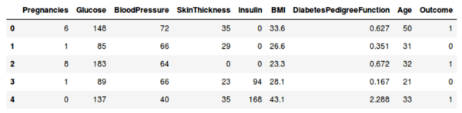
THE DATASET(FIRST FIVE COLUMNS OF OUR DATA SET)

Slide 6
CHECKING THE NULL VALUES
We will be checking if there are any missing values in our data set.
Here, it is evident that we have no missing or null values.
Pregnancies 0
Glucose 0
BloodPressure 0
SkinThickness 0
Insulin 0
BMI 0
DiabetesPedigreeFunction 0
Age 0
Outcome 0
dtype: int64

Slide 7
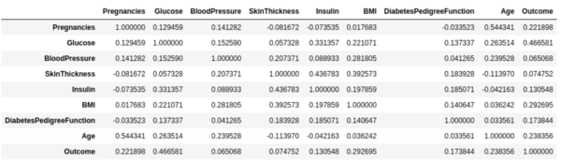
The Correlation:

Slide 8
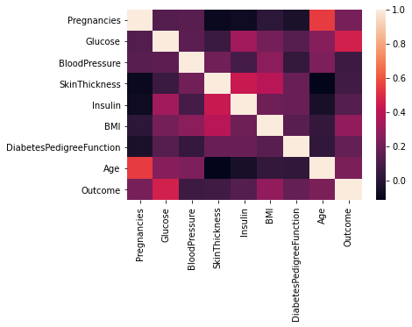
Heatmap(EDA) of the Correlation

Slide 9
THE BASICS OF CORRELATION:
Interpreting the correlation
Positive 1—1.000 means that there is a perfect, positive correlation between two features, as one feature goes up, the other goes up exactly in proportion.
If there is a negative number
Zero 1—0.000 means there is no correlation positive or negative between two features. They move completely at random to one another.
Negative 1—-1.000 means that there is a perfect, negative or inverse correlation between two features. As one feature goes up, the other goes down and vise versa.
–1. A perfect negative (downward sloping) linear relationship
–0.70. A strong negative (downward sloping) linear relationship
–0.50. A moderate negative (downhill sloping) relationship
–0.30. A weak negative (downhill sloping) linear relationship
0. No linear relationship
+0.30. A weak positive (upward sloping) linear relationship
+0.50. A moderate positive (upward sloping) linear relationship
+0.70. A strong positive (upward sloping) linear relationship
+1. A perfect positive (upward sloping) linear relationship

Slide 10
OBSERVATIONS OF CORRELATION
In the above heatmap, brighter colors indicate more correlation. As we can see from the table and the heatmap, glucose levels, age, BMI and number of pregnancies all have significant correlation with the outcome variable. Also notice the correlation between pairs of features, like age and pregnancies, or insulin and skin thickness.

Slide 11
Pregnancies Vs Age
Higher the age lower is the pregnancy rate, however there is a lesser pregnancy rate among women below the age of 20 which is quite obvious.
The correlation of pregnancy and age is of 0.54 which indicates a moderate linear relationship, though not a strong relationship but it can be considered.

Slide 12
Glucose vs Outcome
We see a positive relationship between glucose and outcome indicating that higher the glucose the more are the chances of people being diabetic.
The correlation of Outcome of being diabetic and the glucose level is of 0.46 which indicates a moderate positive relationship(uphill slope)

Slide 13
Insulin vs Skin thickness
The correlation indicates that higher is the skin thickness the more is the insulin level.
The correlation of both is of 0.43 which again denotes a moderate linear relationship on a positive side .

Slide 14
Insulin Vs Age
The age and insulin correlation a linear negative relationship which indicates that higher the age i.e as the age increases the insulin level among people tends to decrease.
The correlation is of -0.42 which indicates a negative linear relationship of moderate level.

Slide 15
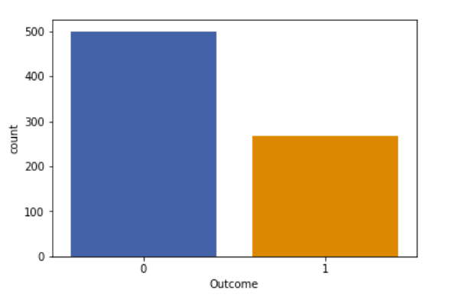
EXPLORATORY DATA ANALYSIS
Let’s also look at how many people in the dataset are diabetic and how many are not. Here is the barplot of the same:
The number of non diabetic people is more as compared to the ones who are diabetic

Slide 16
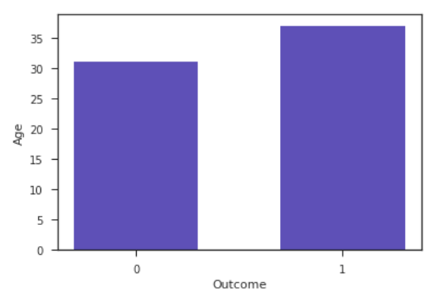
Age Vs Outcome Plot
People of age more than 30 are more prone to diabetes as compared to the ones who are of less age which is quite obvious. As our age increases the physical activity tends to decrease and health related problems are quite common among the ones who are older in age.

Slide 17
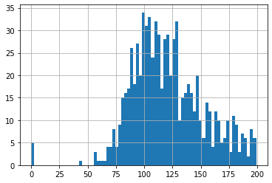
Glucose :
This plot shows that most people have a glucose level of around 90 to 126.

Slide 18
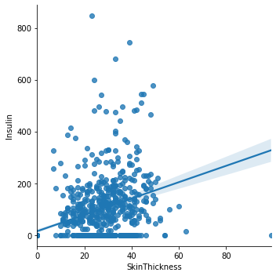
Skin thickness and Insulin
This lmplot shows a linear relationship between skin thickness and Insulin.
Our correlation table indicated earlier that the relationship between skin thickness and insulin is of 0.54 which is moderate and positive.

Slide 19
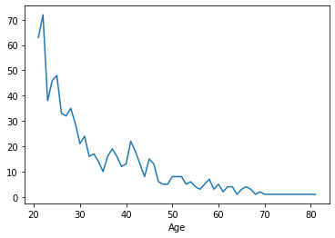
Age Vs Pregnancies
This kde plot shows that the number of pregnancies is highest 20s and 30s and tends to decrease after the age of 30.

Slide 20
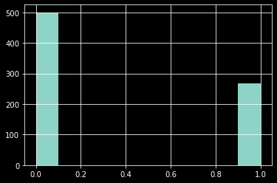
Number Of Diabetics:
This pandas dark visualization shows that the number of non diabetics are higher than the number of diabetics.

Slide 21
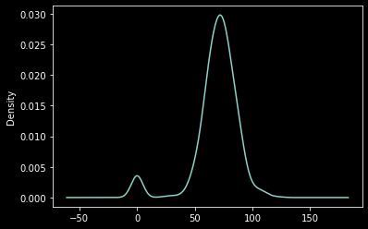
KDE plot:
The common blood pressure among the people is of around 80 which is the blood pressure of a healthy person.

Slide 22
Training and testing the model steps:
Step 1 — Split dataset into “X” features and “y” label :This step is required to prepare us for the fitting (i.e. training) the model later. The “X” variable is a collection of all the features. Think of this as ‘pregnancies’, ‘insulin’, ‘Age’, etc.. The “y” variable is the target label which specifies whether the individual is diabetic or not. Our goal will be to identify which category the data point should fall into.

Slide 23
Step 2:
Split the data into a training and test set
This allows for use to train our model on the training set and evaluate the built model against the test set to identify errors.

Slide 24
Step 3:
Create and Train the Model
Here we create a Logistic Regression Object and use the .fit() method to finally train the model. Upon completion of the model we should receive confirmation that the training has been completed.

Slide 25
STEP 4:
Evaluate the Model by reviewing the classification report or confusion matrix. By reviewing these tables, we are able to evaluate the model.

Slide 26
THE RESULTS – A COMPLETE UNDERSTANDING
precision recall f1-score support <- CLASSIFICATION METRICS
0 0.81 0.81 0.81 168
1 0.63 0.63 0.63 86
accuracy 0.75 254
macro avg 0.72 0.72 0.72 254
weighted avg 0.75 0.75 0.75 254
[[136 32] <- CONFUSION MATRIX
[ 32 54]]

Slide 27
CONFUSION MATRIX
Here,
D – Diabetic
N.D– NOT Diabetic
Predicted
D N.D
actual D [[136 32]
N.D [ 32 54]]
A true positive is an outcome where the model correctly predicts the positive class. Similarly, a true negative is an outcome where the model correctly predicts the negative class.
A false positive is an outcome where the model incorrectly predicts the positive class. And a false negative is an outcome where the model incorrectly predicts the negative class.
The matrix interprets:
Our model predicts that:
148 is the true positive i.e 136 people are diabetic and our model predicted correctly.
32 is the false negative i.e 32 people are diabetic and our model was incorrect and predicted that they did not have diabetes.
32 is the false positive i.e 32 person did not have diabetes but the model predicted that they have diabetes.
54 is the true negative i.e 54 people did not have diabetes and our model predicted correctly.

Slide 28
ACCURACY
precision recall f1-score support
0 0.81 0.81 0.81 168
1 0.63 0.63 0.63 86
accuracy 0.75 254
macro avg 0.72 0.72 0.72 254
weighted avg 0.75 0.75 0.75 254
This metrics tells us about in total how many predictions by our model were correct. So , we can see that accuracy is of 75%, that is out of 254 data values 75% data was correctly predicted i.e 190 values out of 254 were correctly predicted which makes to 75% of accuracy.

Slide 29
The major problem with the accuracy:
The reason is that accuracy score can be misleading if our dataset is imbalanced.
An easy example : An imbalanced dataset means that suppose we have 1000 individuals out of which 999 did not have diabetes while 1 individual had diabetes. If we train our model on this data, it becomes biased towards people that did not have diabetes. Since it has only seen one individual which has diabetes, while rest of the individuals did not have it, it tends to predict any new person coming as non diabetic. Suppose, we trained our model and applied it on 5 individuals. Out of the 5, 3 didn’t have diabetes while 2 did. But since the model is biased, may be it will predict all the 5 as not diabetic. So the accuracy will be 75%. But suppose all the 5 individuals have diabetes, and model predicted 4 did not have diabetes. This time the accuracy will be only 20% (1/5). Therefore, as the dataset changes, the accuracy changes as well and we cannot solely depend on it. Let us see how Precision and Recall tries to address this issue.

Slide 30
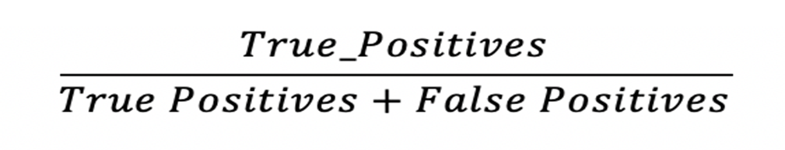
PRECISION
Precision talks about all the correct predictions out of total positive predictions. Recall means how many individuals were classified correctly out of all the actual positive individuals.
Here our precision is found to be 72% correct which means out of all to be correct predictions, 72% of them were correctly predicted while 28% were not.

Slide 31
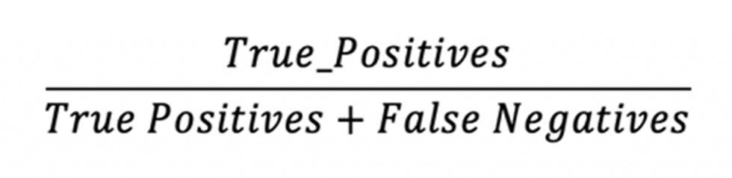
RECALL
Recall – Recall means how many individuals were classified correctly out of all the actual positive individuals.
Our recall value is 72% which means that in our case the positive scenario was ‘being diabetic’ and out of all the positive scenarios 72% of people that were diabetic were predicted correctly.
Due to such results we can say that our model’s predictions is on a good note, however to make sure the F1 score comes into play.

Slide 32
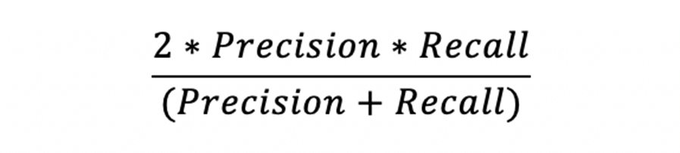
F1 SCORE
Should we always look at both the values? Can’t there be only one value with which we can make a judgement of the model? Yes! F1 Score is the answer. Only by looking at this score we can decide on the model, without looking at Precision and Recall. F1 Score is derived from the P&R score only, and Higher the value of F1 Score, better is the model. If we are curious about F1 Score’s result, then we can always look at the precision and recall score and judge which metrics is driving a major role in affecting F1 Score as it takes both the metrics into consideration. F1 Score is the harmonic mean of Precision and Recall.
The F1 score comes out to be 72% , hence the F1 score prediction is on a better scale and our model’s predictions are at a correct scale of 72%

Slide 33
DECISION TREES ALGORITHM
The decision tree algorithm tries to solve the problem, by using tree representation. Each internal node of the tree corresponds to an attribute, and each leaf node corresponds to a class label.

Slide 34
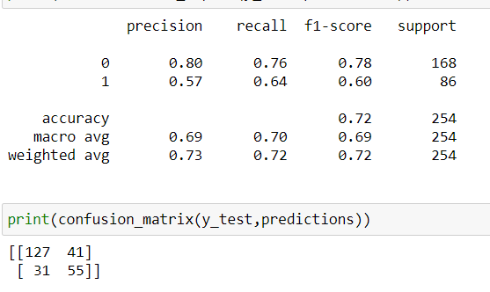
THE OBSERVATION

Slide 35
ACCURACY COMPARISION
This metrics tells us about in total how many predictions by our model were correct. So , we can see that accuracy is of 72%, that is out of 254 data values 72% data was correctly predicted i.e 182 values out of 254 were correctly predicted which makes to 72% of accuracy.
However, the logistic regression algorithm gave us 190 values correct and an accuracy of 75% which is higher than the decision trees accuracy

Slide 36
RANDOM FOREST CLASSIFIER
Random forest is a flexible, easy to use machine learning algorithm that produces, even without hyper-parameter tuning, a great result most of the time. It is also one of the most used algorithms, because of its simplicity and diversity (it can be used for both classification and regression tasks).

Slide 37
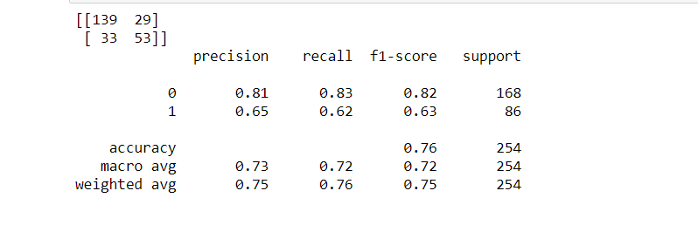
THE OBSERVATION

Slide 38
ACCURACY COMPARISION
This metrics tells us about in total how many predictions by our model were correct. So , we can see that accuracy is of 76%, that is out of 254 data values 76% data was correctly predicted i.e 192 values out of 254 were correctly predicted which makes to 76% of accuracy.
This accuracy is even higher than logistic regression 75% and decision trees 72% accuracy level.

Slide 39
CONCLUSION
When the accuracy compared for our dataset using 3 different algorithms it was found that the random forest predicted 192 values out of 254 with an accuracy of 76%, this was found to be highest accuracy.
Then followed by logistic regression which predicted 190 values correctly out of 254 with an accuracy of 75%.
The least accurate was decision trees algorithm with a correct prediction of 182 values and an accuracy of 72%

Slide 40
K-NEAREST NEIGHBOURS
KNN algorithm is one of the simplest classification algorithm and it is one of the most used learning algorithms. KNN is a non-parametric, lazy learning algorithm. Its purpose is to use a database in which the data points are separated into several classes to predict the classification of a new sample point.

Slide 41
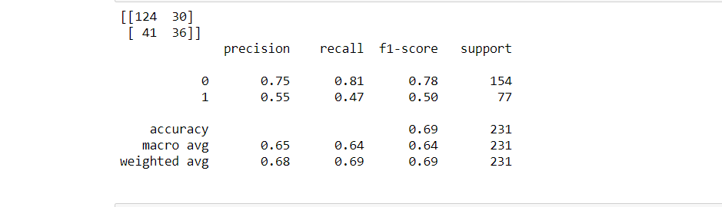
THE OBSERVATION

Slide 42
COMPARISION
This metrics tells us about in total how many predictions by our model were correct. So , we can see that accuracy is of 69%, that is out of 231 data values 69% data was correctly predicted i.e 160 values out of 231 were correctly predicted which makes to 69% of accuracy.
This accuracy is even lower than decision trees 72% and accuracy level.

Slide 43
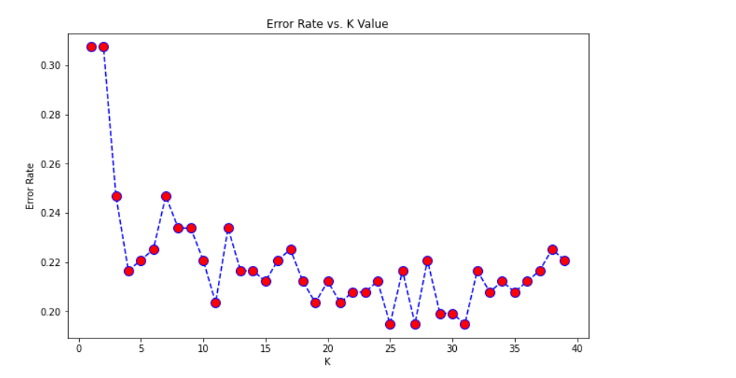
USING A DIFFERENT K- VALUE

Slide 44
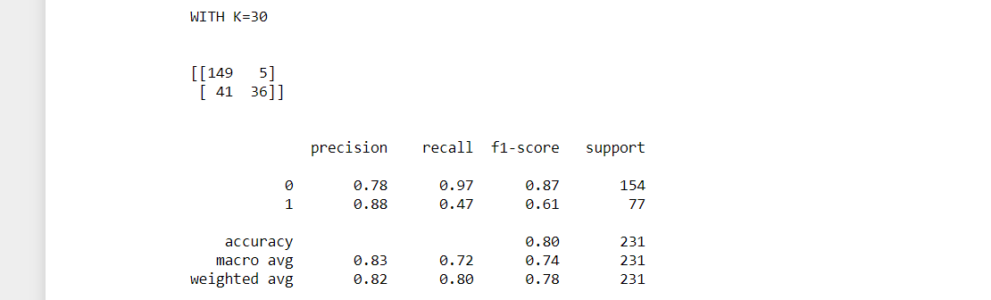
THE OBSERVATION

Slide 45
COMPARISION
This metrics tells us about in total how many predictions by our model were correct. So , we can see that accuracy is of 80%, that is out of 231 data values 80% data was correctly predicted i.e 185 values out of 231 were correctly predicted which makes to 80% of accuracy.
This accuracy is even higher than random forest classifier having 76%.

Slide 46
SUPPORT VECTOR MACHINE
Support vector machines (SVMs) are powerful yet flexible supervised machine learning algorithms which are used both for classification and regression. But generally, they are used in classification problems. SVMs have their unique way of implementation as compared to other machine learning algorithms.

Slide 47
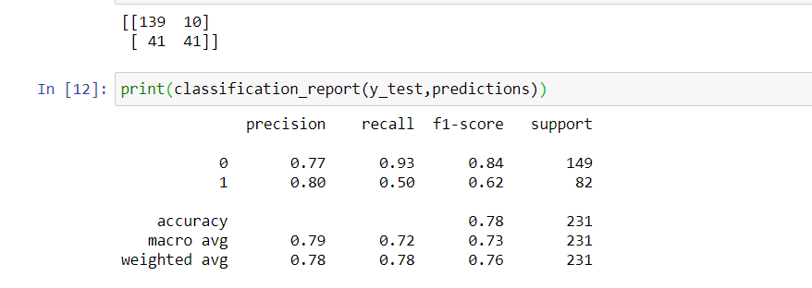
THE OBSERVATION

Slide 48
COMPARISION
This metrics tells us about in total how many predictions by our model were correct. So , we can see that accuracy is of 78%, that is out of 231 data values 78% data was correctly predicted i.e 180 values out of 231 were correctly predicted which makes to 78% of accuracy.
This accuracy is lower than KNN having 80% accuracy.

Slide 49
CONCLUSION
When the accuracy compared for our dataset using 5 different algorithms it was found that the KNN predicted and gave 80% accuracy, this was found to be highest accuracy.
Then followed by random forest classifier and SVM which predicted with an accuracy of 78%.
Then followed by logistic regression with an accuracy of 75%
The least accurate was decision trees algorithm with a correct prediction of 182 values and an accuracy of 72%

Slide 50
IMBALANCED DATA
Imbalance data distribution is an important part of machine learning workflow. An imbalanced dataset means instances of one of the two classes is higher than the other, in another way, the number of observations is not the same for all the classes in a classification dataset

Slide 51
HANDLING THE IMBALANCED DATASET
Random Under-Sampling:
Random Under sampling aims to balance class distribution by randomly eliminating majority class examples. This is done until the majority and minority class instances are balanced out.
DISADVANTAGE: It can discard potentially useful information which could be important for building rule classifiers.

Slide 52
HANDLING THE IMBALANCED DATASET
Random Over-Sampling: Over-Sampling increases the number of instances in the minority class by randomly replicating them in order to present a higher representation of the minority class in the sample
Disadvantages:
It increases the likelihood of overfitting since it replicates the minority class events.

Slide 53
HANDLING THE IMBALANCED DATASET
One of the advanced bagging techniques commonly used to counter the imbalanced dataset problem is SMOTE bagging. It follows an entirely different approach from conventional bagging to create each Bag/Bootstrap. It generates the positive instances by the SMOTE Algorithm by setting a SMOTE resampling rate in each iteration. The set of negative instances is bootstrapped in each iteration.

Slide 54
HANDLING THE IMBALANCED DATASET
The easiest way to successfully generalize a model is by using more data. The problem is that out-of-the-box classifiers like logistic regression or random forest tend to generalize by discarding the rare class. One easy best practice is building n models that use all the samples of the rare class and n-differing samples of the abundant class. Given that you want to ensemble 10 models, you would keep e.g. the 1.000 cases of the rare class and randomly sample 10.000 cases of the abundant class. Then you just split the 10.000 cases in 10 chunks and train 10 different models.

Slide 55
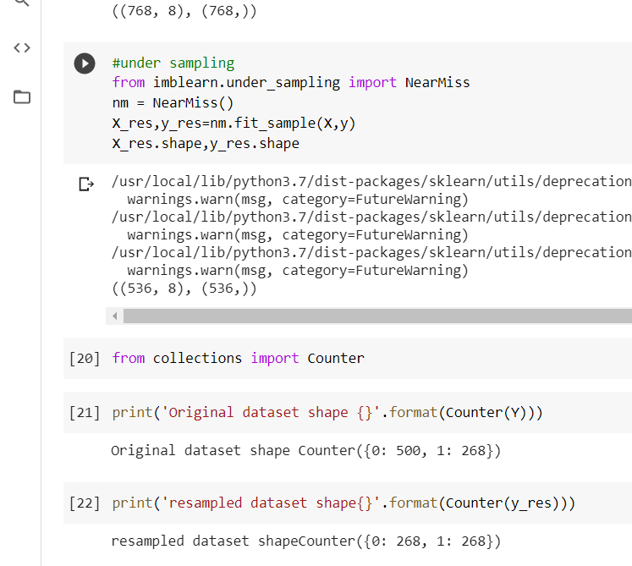
UNDERSAMPLING
This technique samples down or reduces the samples of the class containing more data equivalent to the class containing the least samples. Suppose class A has 900 samples and class B has 100 samples, then the imbalance ratio is 9:1. Using the undersampling technique we keep class B as 100 samples and from class A we randomly select 100 samples out of 900. Then the ratio becomes 1:1 and we can say it’s balanced.

Slide 56
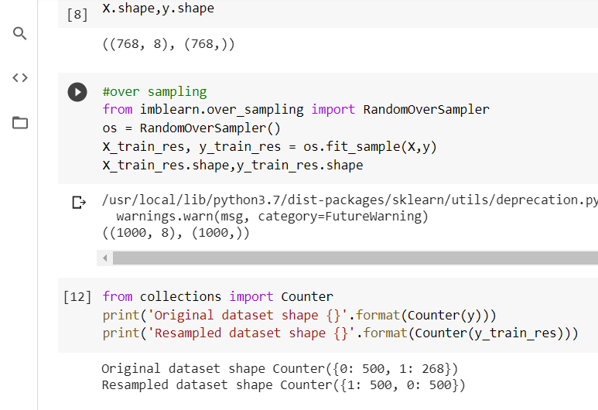
Oversampling
Oversampling is just the opposite of under sampling. Here the class containing less data is made equivalent to the class containing more data. This is done by adding more data to the least sample containing class. Let’s take the same example of undersampling, then, in this case, class A will remain 900 and class B will also be 900 (which was previously 100). Hence the ratio will be 1:1 and it’ll be balanced.

Slide 57
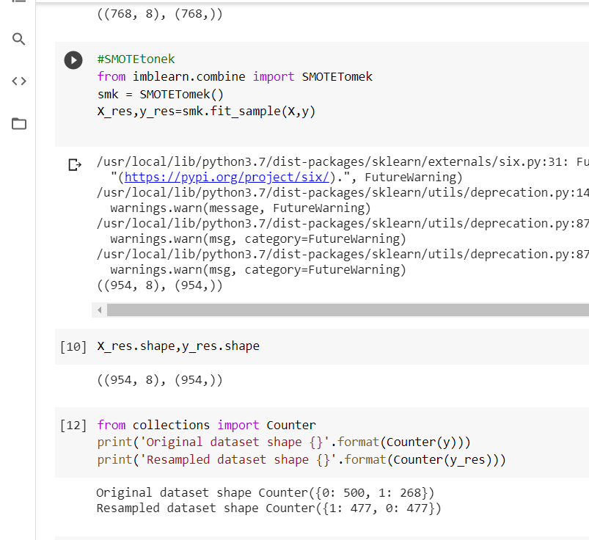
SMOTEtonek
SMOTETomek is somewhere upsampling and downsampling. SMOTETomek is a hybrid method which is a mixture of the above two methods, it uses an under-sampling method (Tomek) with an oversampling method (SMOTE). This is present within imblearn.combine module.

Slide 58
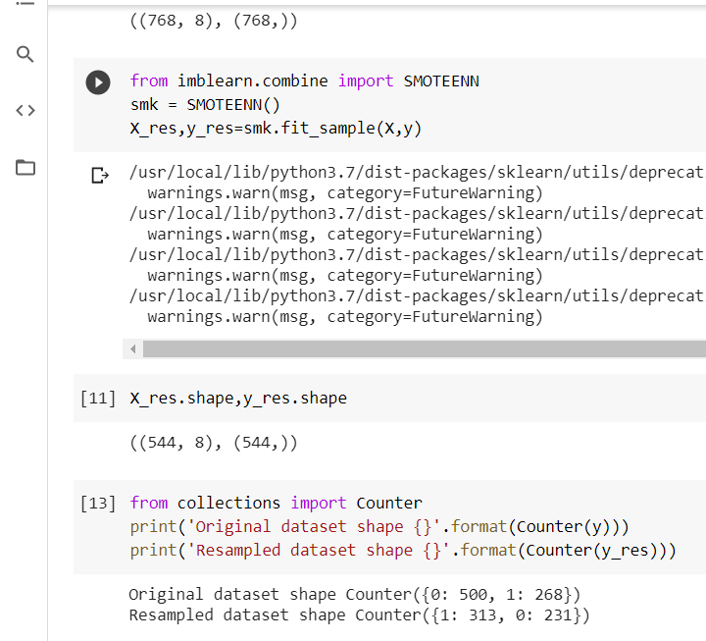
SMOTE-EENN
Unlike SMOTETomek the ratio is not 1:1 but the difference between the samples is not very large.
In all these above 4 techniques there is an important parameter called sampling_strategy, this simply means how the resampling should be done. By default, it’s set to ‘auto’.

Slide 59
Ensemble techniques
The ensemble methods, also known as committee-based learning or learning multiple classifier systems train multiple hypotheses to solve the same problem. One of the most common examples of ensemble modelling is the random forest trees where a number of decision trees are used to predict outcomes.
Ensemble methods are techniques that create multiple models and then combine them to produce improved results. Ensemble methods usually produces more accurate solutions than a single model would

Slide 60
SIMPLE ENSEMBLE TECHNIQUES
Max Voting:
The max voting method is generally used for classification problems. In this technique, multiple models are used to make predictions for each data point. The predictions by each model are considered as a ‘vote’. The predictions which we get from the majority of the models are used as the final prediction.
For example, when you asked 5 of your colleagues to rate your movie (out of 5); we’ll assume three of them rated it as 4 while two of them gave it a 5. Since the majority gave a rating of 4, the final rating will be taken as 4.

Slide 61
AVERAGING
Similar to the max voting technique, multiple predictions are made for each data point in averaging. In this method, we take an average of predictions from all the models and use it to make the final prediction. Averaging can be used for making predictions in regression problems or while calculating probabilities for classification problems.

Slide 62
Weighted Average
This is an extension of the averaging method. All models are assigned different weights defining the importance of each model for prediction. For instance, if two of your colleagues are critics, while others have no prior experience in this field, then the answers by these two friends are given more importance as compared to the other people.

Slide 63
Advanced Ensemble techniques
Stacking is an ensemble learning technique that uses predictions from multiple models (for example decision tree, knn or svm) to build a new model. This model is used for making predictions on the test set. Below is a step-wise explanation for a simple stacked ensemble:

Slide 64
Bagging
The idea behind bagging is combining the results of multiple models (for instance, all decision trees) to get a generalized result. Here’s a question: If you create all the models on the same set of data and combine it, will it be useful? There is a high chance that these models will give the same result since they are getting the same input. So how can we solve this problem? One of the techniques is bootstrapping.
Bootstrapping is a sampling technique in which we create subsets of observations from the original dataset, with replacement. The size of the subsets is the same as the size of the original set.
Bagging (or Bootstrap Aggregating) technique uses these subsets (bags) to get a fair idea of the distribution (complete set). The size of subsets created for bagging may be less than the original set.

Slide 65
Bagging
Multiple subsets are created from the original dataset, selecting observations with replacement.
A base model (weak model) is created on each of these subsets.
The models run in parallel and are independent of each other.
The final predictions are determined by combining the predictions from all the models

Slide 66
Boosting
If a data point is incorrectly predicted by the first model, and then the next (probably all models), will combining the predictions provide better results? Such situations are taken care of by boosting.
Boosting is a sequential process, where each subsequent model attempts to correct the errors of the previous model. The succeeding models are dependent on the previous model. Let’s understand the way boosting works in the below steps.
A subset is created from the original dataset.
Initially, all data points are given equal weights.
A base model is created on this subset.
This model is used to make predictions on the whole dataset

Slide 67
Algorithms based on Bagging and Boosting
Bagging algorithms:
Bagging meta-estimator
Random forest
Boosting algorithms:
AdaBoost
GBM
XGBM
Light GBM
CatBoost

Slide 68
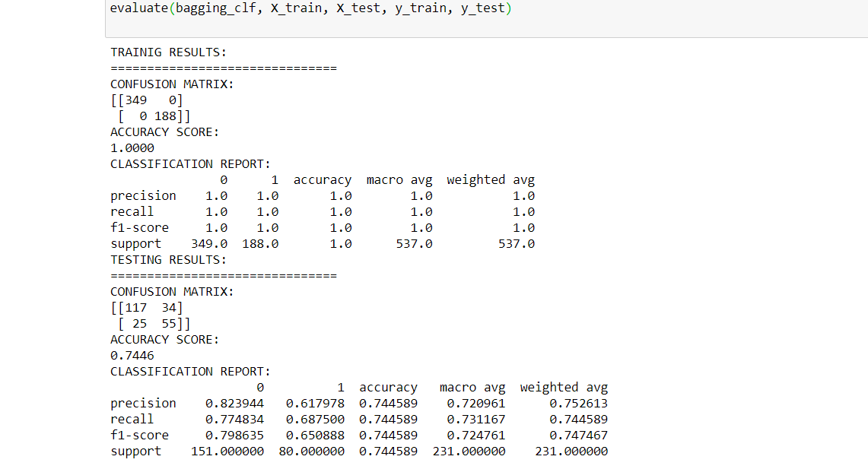
Ensemble methods on dataset(Bagging)
A Bagging classifier is an ensemble meta-estimator that fits base classifiers each on random subsets of the original dataset and then aggregate their individual predictions (either by voting or by averaging) to form a final prediction.

Slide 69
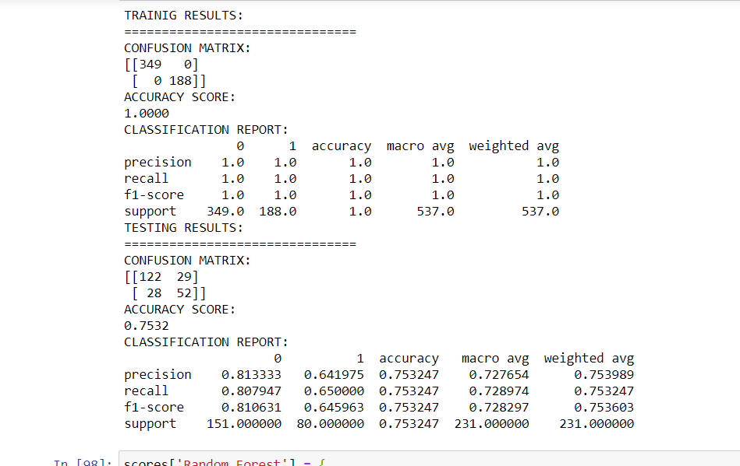
RANDOM FOREST
A random forest is a meta estimator that fits a number of decision tree classifiers on various sub-samples of the dataset and uses averaging to improve the predictive accuracy and control over-fitting.

Slide 70
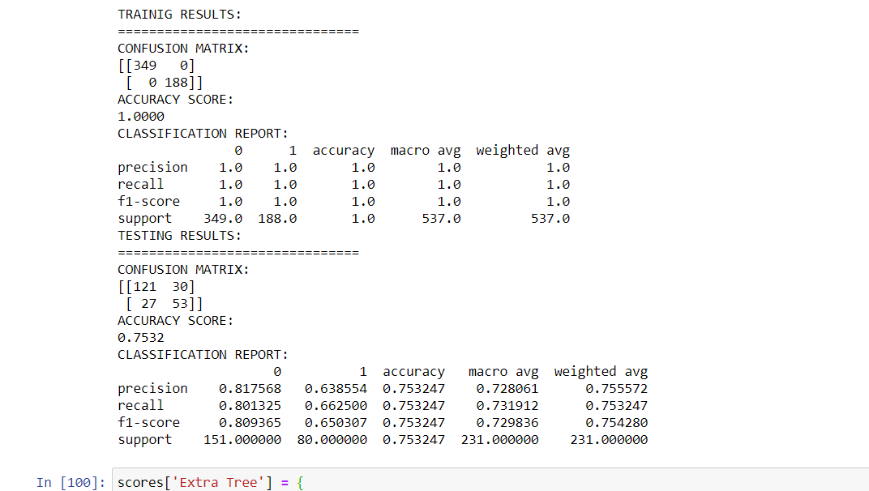
Extra trees classifier
Extra Trees are another modification of bagging where random trees are constructed from samples of the training dataset.
You can construct an Extra Trees model for classification using the ExtraTreesClassifier class.

Slide 71
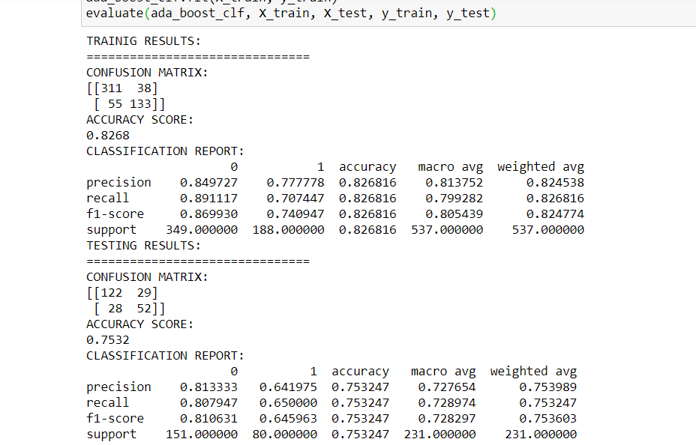
Ada Boost
An AdaBoost classifier is a meta-estimator that begins by fitting a classifier on the original dataset and then fits additional copies of the classifier on the same dataset but where the weights of incorrectly classified instances are adjusted such that subsequent classifiers focus more on difficult cases.

Slide 72
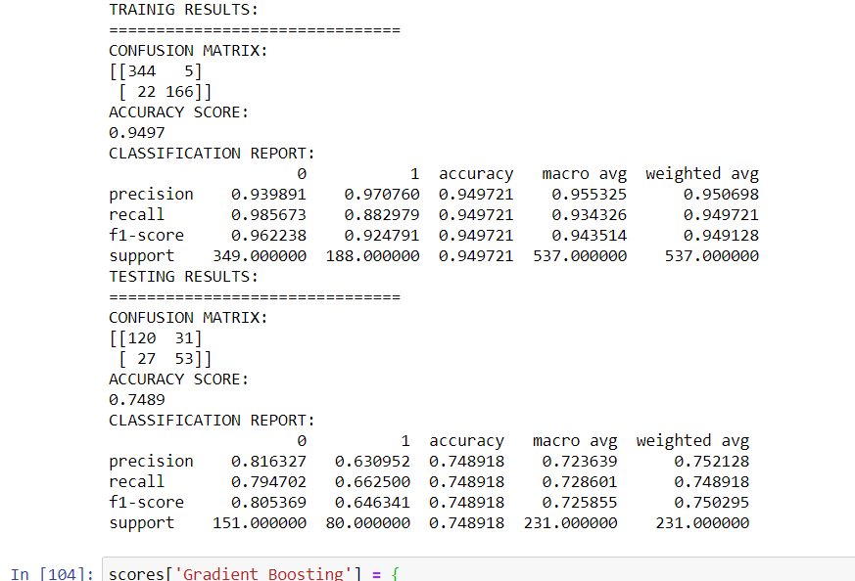
Gradient boosting
GB builds an additive model in a forward stage-wise fashion; it allows for the optimization of arbitrary differentiable loss functions

Slide 73
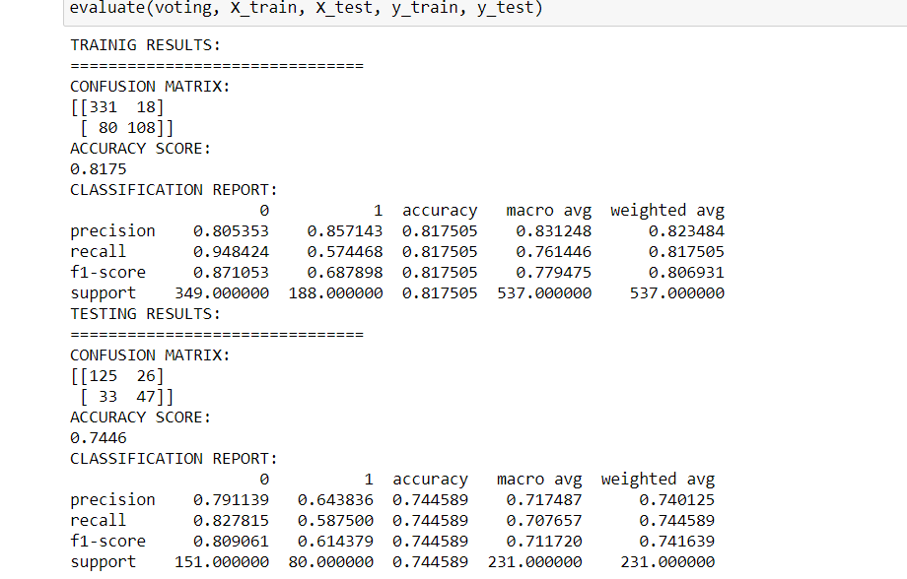
Voting classifier
Voting is one of the simplest ways of combining the predictions from multiple machine learning algorithms.
It works by first creating two or more standalone models from your training dataset. A Voting Classifier can then be used to wrap your models and average the predictions of the sub-models when asked to make predictions for new data.

Slide 74
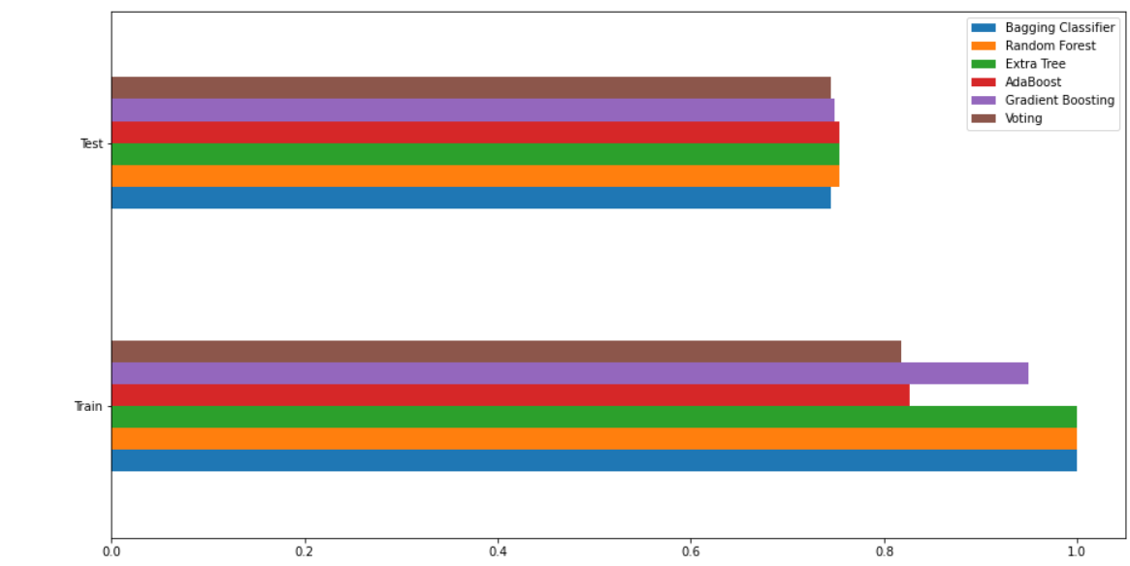
COMPARISON OF ACCURACY

Slide 75
CONCLUSION
In the previous slide of comparison we can redeem that Ada boost, extra tree and random forest were found out to be the ones having the best accuracy of our data.
Also, these 3 performed and showed accuracy at the same level.
Voting and bagging classifier were at same level after the former 3.
The one with the least frequency out of all was the voting classifier.
What we did in a short summarized points:
1).Bagging Ensembles including Bagged Decision Trees, Random Forest and Extra Trees.
2).Boosting Ensembles including AdaBoost and Stochastic Gradient Boosting.
3).Voting Ensembles for averaging the predictions for any arbitrary models.

Slide 76
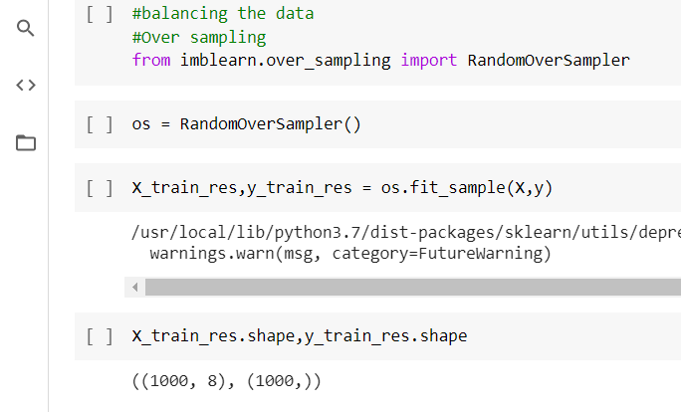
BALANCING THE DATA IN A NEW WAY AND APPLYING ENSEMBLE TECHNIQUES
Firstly, the data is balanced using a over sampling ensemble technique

Slide 77
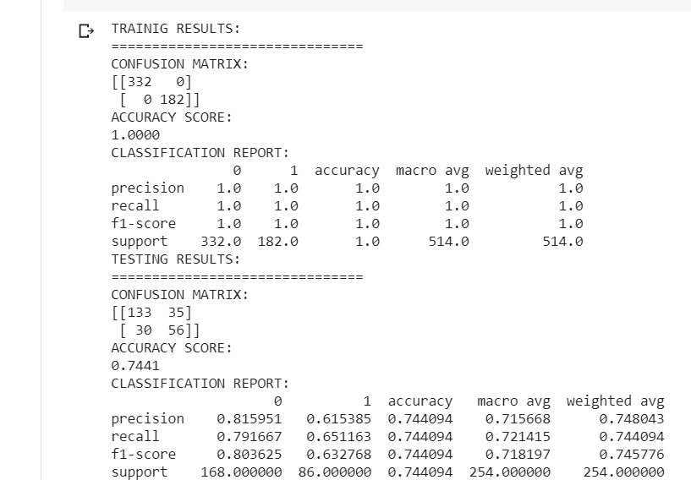
TECHNIQUES APPLIED
Using the bagging classifier technique gave us an accuracy of 74%

Slide 78
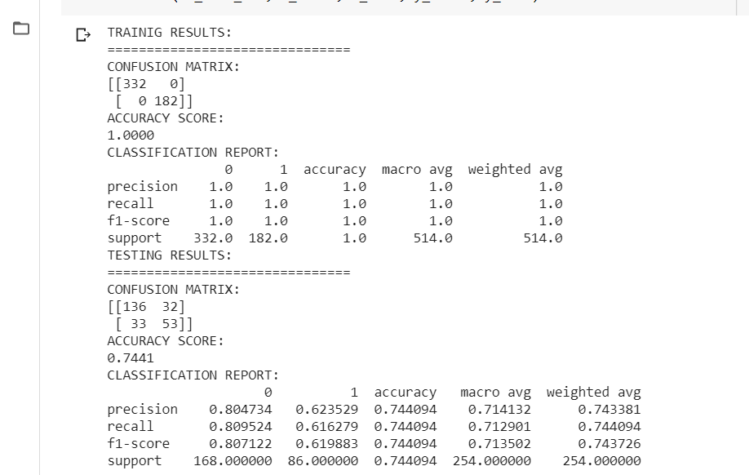
Extra trees classifier
Again, this classifier gave us 74% of accuracy

Slide 79
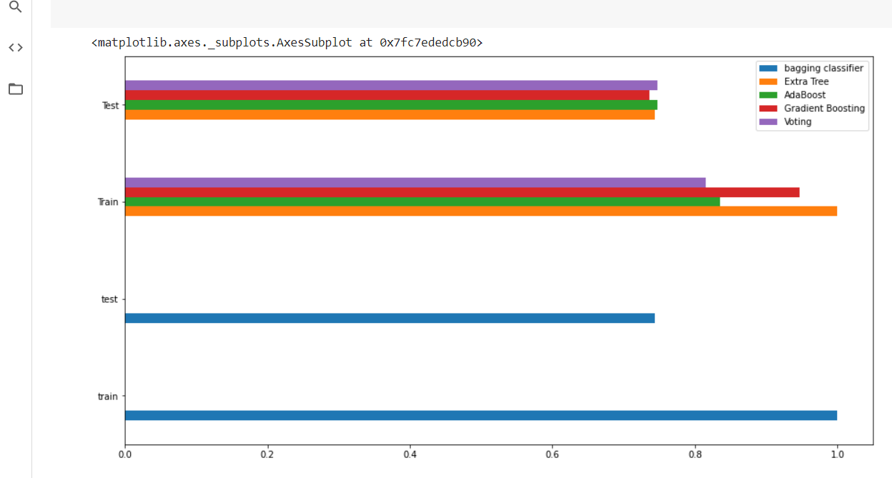
Let us finally go to conclusion of the results

Slide 80
END RESULT
The highest accuracy was by the ada boost classifier and the voting classifier.
These results followed by the bagging classifier and extra trees classifier.
The one with least result was gradient boosting technique

